Slide 1
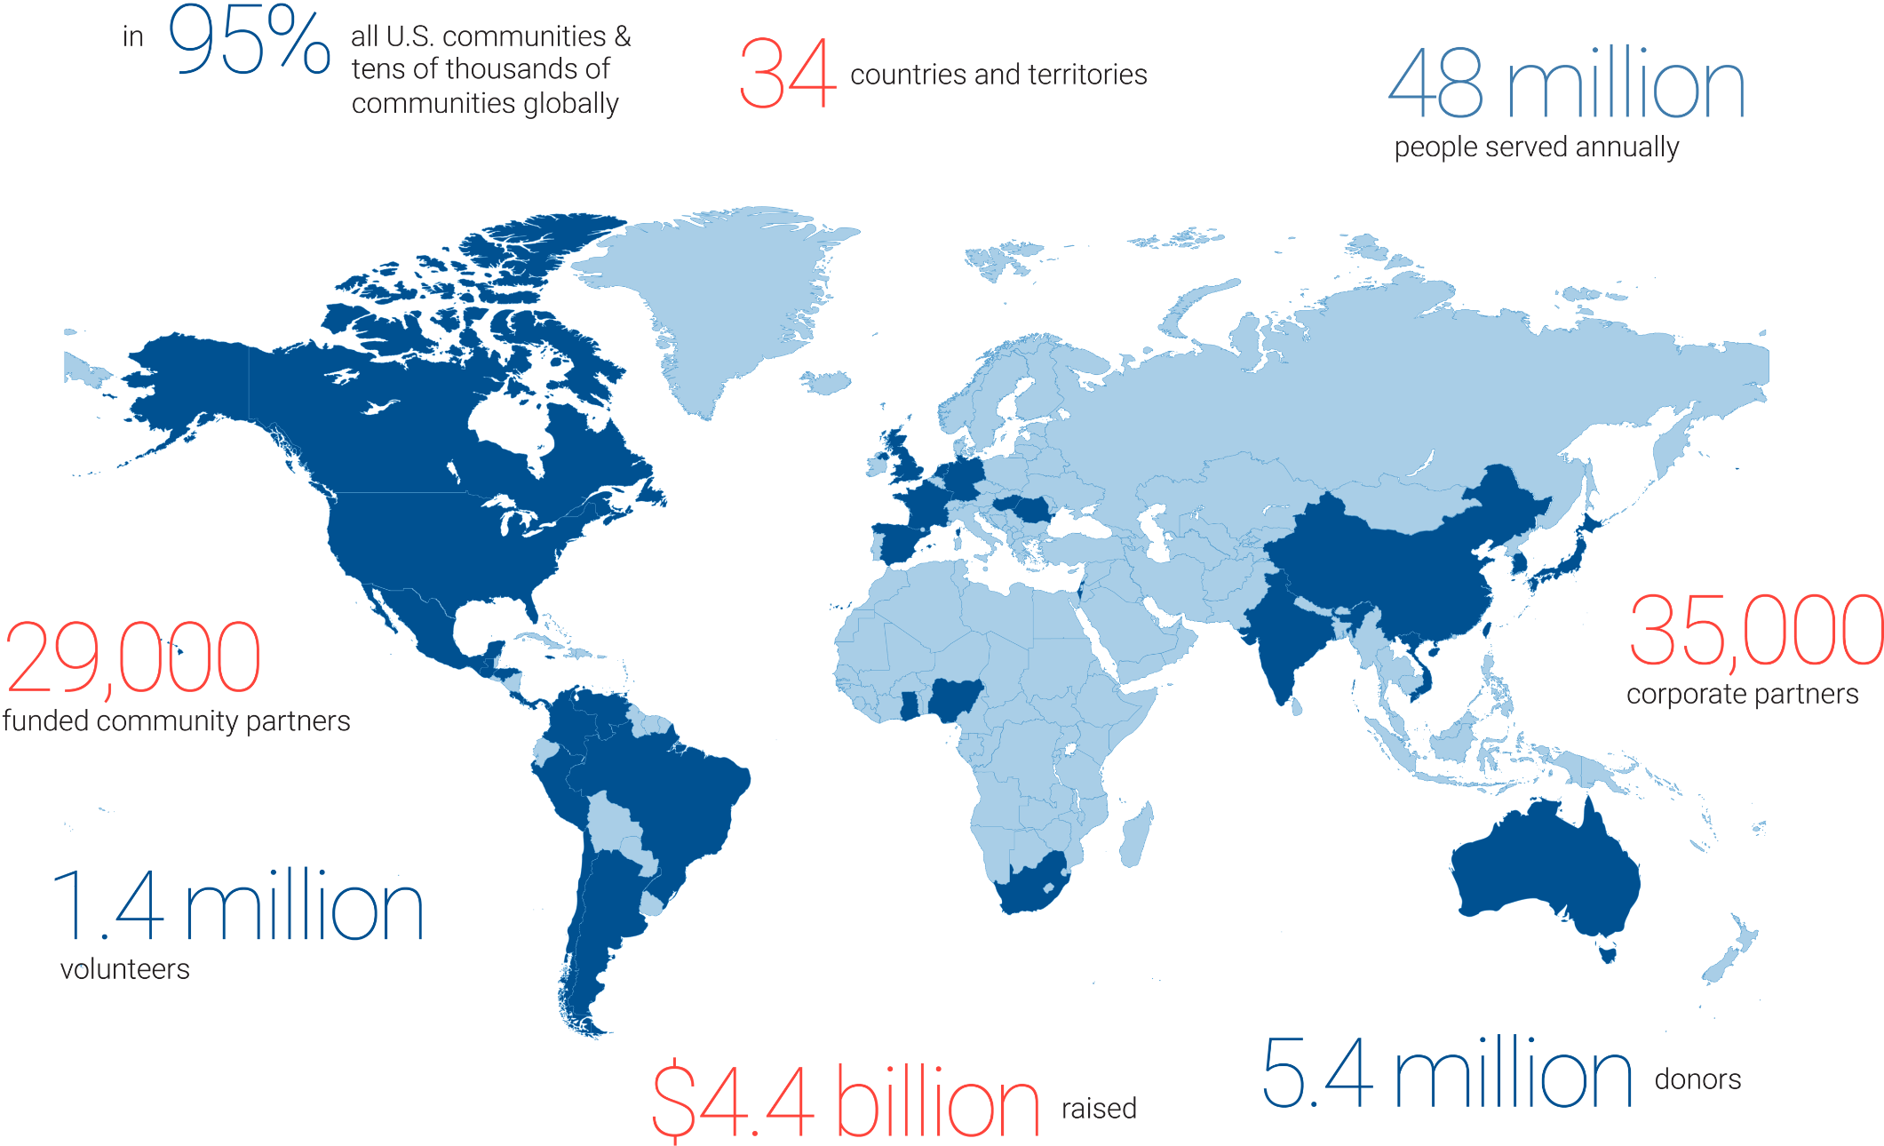
United Way:
A Global Network
For Good
Our Vision
United Way envisions a world where every person in every community is thriving.
Our Mission
To improve lives by mobilizing the caring power of communities around the world.

